Slide 1

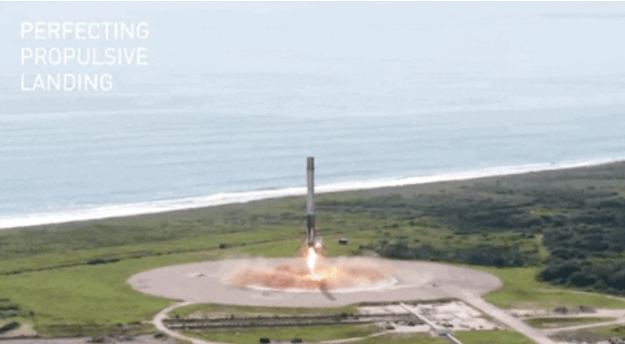
Rose-Marie PIPOKA
22/02/2025

Slide 2
Outline
Executive Summary
Introduction
Methodology
Results
Conclusion

Slide 3
Executive Summary
Summary of methodologies
Data was collected via the SpaceX API and web scraping. It was cleaned, filtered for Falcon 9 launches, and missing PayloadMass values were replaced with the average. Additional details were enriched using the API.
Summary of all results
After performing four classification models (Decision Tree, K-Nearest Neighbors, SVM, Logistic Regression), we observed that the Decision Tree model is the best-performing one. Therefore, we will focus on this model.
Our analysis also shows that KSC LC-39A has the highest success rate among all launch sites

Slide 4
Introduction
Project background and context
With the rapid rise of commercial spaceflight, companies like Virgin Galactic, Rocket Lab, and Blue Origin are transforming access to space. However, SpaceX, founded by Elon Musk, stands out by significantly lowering launch costs through the reuse of the Falcon 9's first stage. As a result, a SpaceX launch costs around $62 million, compared to over $165 million for other providers.
In this project, as a data scientist at Space Y, a competitor of SpaceX, we will analyze Falcon 9 launch data to predict whether the rocket’s first stage will be successfully recovered. This prediction is key to estimating launch costs and guiding the company’s strategic decisions. To achieve this, we will train a machine learning model and develop an interactive dashboard to support decision-making.
Problems you want to find answers
Witch factors influence the success of the first stage landing
estimate the cost of each launch
Pedict whether space X will reuse the first stage

Slide 5
Section 1

Slide 6
Methodology
Executive Summary
Data collection methodology:
The data used in this project is collected via the SpaceX REST API and web scraping. We use the API api.spacexdata.com/v4/launches/past to retrieve launch information, extracted in JSON format and normalized using the json_normalize function. Additionally, we use BeautifulSoup to scrape HTML tables containing Falcon 9 launch data.
Perform data wrangling
The collected data has been cleaned and transformed.
We filtered only Falcon 9 launches.
We replaced the missing values in PayloadMass with their average and kept the missing values in LandingPad.
We enriched the data by retrieving additional information via the API for columns such as Booster, Launchpad, Payload, and Core

Slide 7
Executive Summary
Perform exploratory data analysis (EDA) using visualization and SQL
After cleaning the data, we conducted an exploratory data analysis using various visualizations.
We created correlation graphs between different attributes.
We observed that the landing success rate has improved since 2013.
We observed that launch sites have varying success rates.
We also performed feature engineering by selecting relevant variables and creating dummy variables for categorical columns. Finally, we analyzed the data using SQL."
Perform interactive visual analytics using Folium and Plotly Dash
Perform predictive analysis using classification models
We used classification models such as Logistic Regression, Decision Trees, Support Vector Machines (SVM), K-Nearest Neighbors (KNN

Slide 8
Data Collection
To collect the data, we proceed as follow:
Import the necessary libraries (Requests, Pandas,numpy …)
Define four functions:
Requesting rocket launch data from SpaceX API with the following URL (spacex_url=https://api.spacexdata.com/v4/launches/past)
Requesting and parsing the SpaceX launch data using the GET request
The data from these requests will be stored in lists and will be used to create a new dataframe
You can see our approach through the organizational chart below.
The first function takes the dataset and uses the "rocket" column to call the API and append the data to the list.
The second function takes the dataset and uses the "launchpad" column to call the API and append the data to the list.
The third function takes the dataset and uses the "payloads" column to call the API and append the data to the lists.
The last function takes the dataset and uses the "cores" column to call the API and append the data to the lists.

Slide 9
Data Collection-API
Libraries importing
(Requests, Pandas, Numpy..)
Defining four functions
The four functions take a dataset and use different columns to call an API and append the retrieved data to lists. The first function uses the "rocket" column, the second uses "launchpad," the third relies on "payloads," and the last one uses "cores" to make the API calls and collect the results.
Requesting rocket launch data from SpaceX API using:
spacex_url=https://api.spacexdata.com/v4/launches/past
response = requests.get(spacex_url)
Create an empty list for each column.
Call each of the functions we defined earlier.
Construct a dictionary to combine the data we have obtained.
Use the dictionary to build the dataset by merging the columns.
Use json_normalize meethod to convert the json result into a dataframe:
data= pd.json_normalize(response.json())
Make requestion JSON more consistent by using:
static_json_url='https://cf-courses-data.s3.us.cloud-object-storage.appdomain.cloud/IBM-DS0321EN-SkillsNetwork/datasets/API_call_spacex_api.json’
response=requests.get(static_json_url)
Github link – Data collecting API

Slide 10
Data Collection - Scraping
Libraries (sys, requests, beautifulsoup, re, pandas)
We perform Webscraping as follow:
Importing libraries (sys, requests, beautifulsoup, re, pandas)
Definition of 5 functions that will be used to process HTML tables retrieved via web scraping
Performing an HTTP GET method to request the Falcon9 Launch HTML page, as an HTTP response.
Create BeautifulSoup Object
Collecting all relevant column names from the HTML table header
Create a data frame by parsing the launch HTML table
GitHub Link-Web scraping
Request the Falcon9 Launch Wiki page from its URL
Html_response = requests.get(static_url)
Create a BeautifulSoup object
html_content = Html_response.text
soup = BeautifulSoup(html_content, 'html.parser')
Extract all column names from the HTML table header
html_tables = soup.find_all('table')
Create a data frame by parsing the launch HTML tables
launch_dict= dict.fromkeys(column_names)
del launch_dict['Date and time ( )']
Create a DataFrame et convert it into csv
df= pd.DataFrame({ key:pd.Series(value) for key, value in launch_dict.items()})
df.to_csv('spacex_web_scraped.csv', index=False)

Slide 11
Data Wrangling
Loading the Dataset into dataframe
df=pd.read_csv("https://cf-courses-data.s3.us.cloud-object-storage.appdomain.cloud/IBM-DS0321EN-SkillsNetwork/datasets/dataset_part_1.csv")
Identifing and calculate the percentage of the missing values
df.isnull().sum()/len(df)*100
Calculate the number of launches on each site
df['LaunchSite'].value_counts()
LaunchSite Counts
CCAFS SLC 40 55
KSC LC 39A 22
VAFB SLC 4E 13
Create a landing outcome label from Outcome column
landing_class = [0 if outcome in bad_outcomes else 1 for outcome in landing_outcomes.index]
Dave Data to csv: df.to_csv("dataset_part_2.csv", index=False)
Calculating the number and occurrence of mission outcomes for each orbit
landing_outcomes=df['Outcome'].value_counts()
landing_outcomes
Determine the number and occurrence of each orbit
df['Orbit'].value_counts()
GitHub Link-Data wrangling

Slide 12
EDA with Data Visualization
We created a catplot to analyze the impact of FlightNumber and PayloadMass on landing success. A FlightNumber vs. PayloadMass chart was plotted, with the launch outcome overlaid
By a catplot, we visualize the relationship between Flight Number and Launch Site
We observed if there is any relationship between launch sites and their payload mass by making a scatterplot
We created a Bar Chart to find if there are any relationship between success rate and orbit type make a bar chart to
We created a scatterplot to see if there is any relationship between FlightNumber and Orbit type
We made a scatterplot to visualize the relationship between Payload Mass and Orbit type
We ploted a linechart to visualize the launch success yearly trend
GitHub Link - EDA

Slide 13
EDA with SQL
Displaying the names of the unique launch sites in the space mission: %sql select distinct Launch_Site from SPACEXTABLE ;
Displaying the names of the unique launch sites in the space mission: %sql select Launch_Site from SPACEXTABLE where Launch_Site LIKE 'CCA%' LIMIT 5;
Displaying the total payload mass carried by boosters launched for NASA (CRS)
%sql select SUM(PAYLOAD_MASS__KG_) from SPACEXTABLE WHERE Customer = 'NASA (CRS)';
Displaying the average payload mass carried by the F9 v1.1 booster version:
%sql select avg(PAYLOAD_MASS__KG_) from SPACEXTABLE where Booster_Version = 'F9 v1.1';
List of the date when the first succesful landing outcome in ground pad was acheived:
%%sql select min(Date) as min_date from spacextbl where Landing__Outcome = 'Success (ground pad)';
Listing the names of boosters that successfully landed on the drone ship and have a payload mass greater than 4000 but less than 6000:
%sql select Booster_Version,Landing_Outcome,PAYLOAD_MASS__KG_ from SPACEXTABLE where Landing_Outcome = 'Success (drone ship)' and PAYLOAD_MASS__KG_ between 4000 and 6000;

Slide 14
EDA with SQL
Listing the total number of successful and failure mission outcomes:
%sql SELECT Landing_Outcome, COUNT(*) AS Total_Count FROM SPACEXTABLE WHERE Landing_Outcome LIKE 'Success%' OR Landing_Outcome LIKE 'Failure%'GROUP BY Landing_Outcome;
Listing the names of the booster_versions which have carried the maximum payload mass. Use a subquery:
%sql SELECT Booster_Version FROM SPACEXTABLE WHERE PAYLOAD_MASS__KG_ = (SELECT MAX(PAYLOAD_MASS__KG_) FROM SPACEXTABLE);
Listing the records displaying the month names, failure landing outcomes on the drone ship, booster versions, and launch sites for the months of the year 2015:
%sql SELECT CASE WHEN substr(Date, 6, 2) = '01' THEN 'January’ WHEN substr(Date, 6, 2) = '02' THEN 'February’ WHEN substr(Date, 6, 2) = '03' THEN 'March’ WHEN substr(Date, 6, 2) = '04' THEN 'April’ WHEN substr(Date, 6, 2) = '05' THEN 'May’ WHEN substr(Date, 6, 2) = '06' THEN 'June’ WHEN substr(Date, 6, 2) = '07' THEN 'July’ WHEN substr(Date, 6, 2) = '08' THEN 'August’ WHEN substr(Date, 6, 2) = '09' THEN 'September’ WHEN substr(Date, 6, 2) = '10' THEN 'October’ WHEN substr(Date, 6, 2) = '11' THEN 'November’ WHEN substr(Date, 6, 2) = '12' THEN 'December' END AS Month,Landing_Outcome, Booster_Version, Launch_Site FROM SPACEXTABLE WHERE substr(Date, 0, 5) = '2015' AND Landing_Outcome = 'Failure (drone ship)';
Ranking the count of landing outcomes (such as Failure (drone ship) or Success (ground pad)) between the date 2010-06-04 and 2017-03-20, in descending order:
%sql SELECT Landing_Outcome, COUNT(*) AS Outcome_Count FROM SPACEXTABLE WHERE Date BETWEEN '2010-06-04' AND '2017-03-20' GROUP BY Landing_Outcome ORDER BY Outcome_Count DESC;
GitHub Link – EDA with SQL

Slide 15
Build an Interactive Map with Folium
We created a folium Map object, with an initial center location to be NASA Johnson Space Center at Houston, Texas.
We used folium.Circle to add a highlighted circle area with a text label on a specific coordinate
We created and add folium.Circle and folium.Marker for each launch site on the site map
We created markers for all launch records. If a launch was successful (class=1), then we use a green marker and if a launch was failed, we use a red marker (class=0)
For each launch result in spacex_df data frame, we added a folium.Marker to marker_cluster
We Calculated the distances between a launch site to its proximities by adding a MousePosition on the map to get coordinate for a mouse
We Created and added a folium.Marker on your selected closest coastline point on the map
We Drawed a PolyLine between a launch site to the selected coastline point
Created a marker with distance to a closest city, railway, highway
We added these objects to analyze and identify the various geographical factors that may influence the launch success rate. Identifying these factors will help determine the optimal location for building a launch site.

Slide 16
Build a Dashboard with Plotly Dash
On the Dashboard we created, we added:
a launch Site Drop-down Input Component
a callback function to render success-pie-chart based on selected site dropdown
a range Slider to Select Payload
a callback function to render the success-payload-scatter-chart scatter plot
We added those plots and interaction to show:
Which site has the largest successful launches
Which site has the highest launch success rate
Which payload range(s) has the highest launch success rate
Which payload range(s) has the lowest launch success rate
Github Link-Dashboard

Slide 17
Predictive Analysis (Classification)
After importing the dataset using pandas, we standardized some features using:
transform = preprocessing.StandardScaler()X = transform.fit_transform(X)
We split the dataset using the train_test_split function:
X_train, X_test, Y_train, Y_test = train_test_split(X, Y, test_size=0.2, random_state=2)
We used GridSearch and tested four models: Logistic Regression, Support Vector Machine, Decision Tree Classifier, and K-Nearest Neighbors Classifier.
For each model, we created a confusion matrix and calculated its accuracy.
Finally, we compared the accuracies of the four models to determine which one performed the best.

Slide 18
Results
Exploratory data analysis results
Interactive analytics demo in screenshots
Predictive analysis results

Slide 19
Section 2

Slide 20
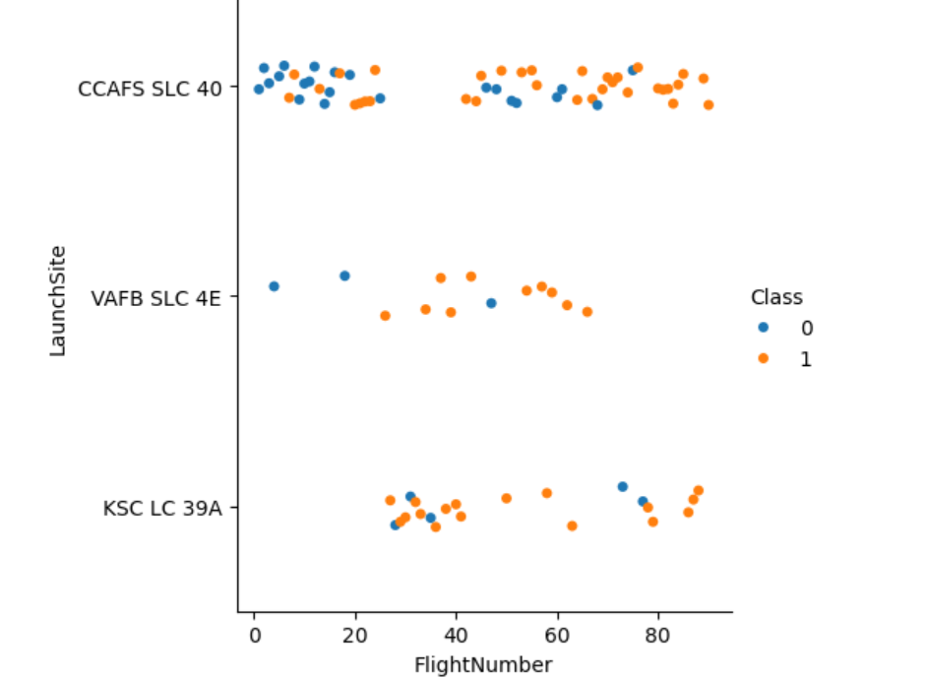
Flight Number vs. Launch Site
scatter plot of Flight Number vs. Launch Site
This scatter plot shows that for CCAFS SLC 40, failures and successes are mixed, but there seem to be more successful launches in recent flights.For VAFB SLC 4E, there is a mix of failures and successes without a clear trend.For KSC LC 39A, recent flights appear to have more successes than failures.

Slide 21
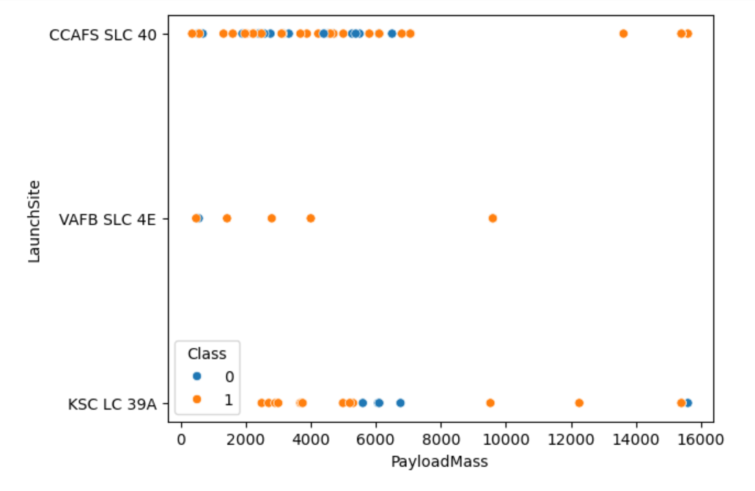
Payload vs. Launch Site
Scatter plot of Payload vs. Launch Site
This scatter plot shows that heavy payloads (>10,000 kg) mostly succeed, especially at KSC LC 39A and CCAFS SLC 40.Failures are more common for intermediate payloads (~6,000 kg), particularly at KSC LC 39A.The VAFB SLC 4E site has few failures, though the total number of launches there is low.

Slide 22
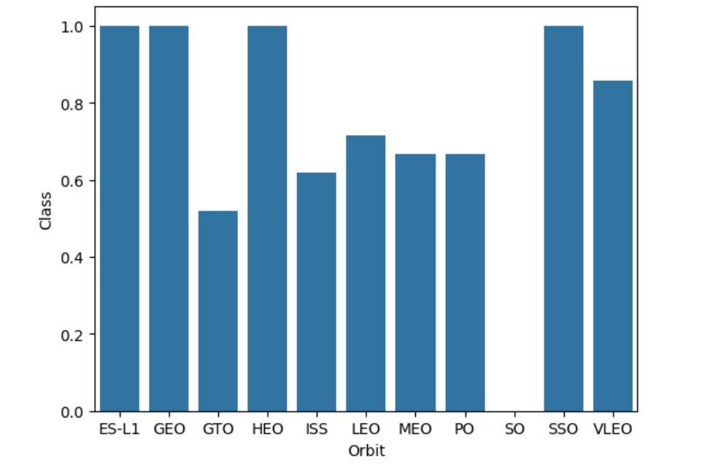
Success Rate vs. Orbit Type
Bar chart for the success rate of each orbit type
This bar chart represents the success rate (Class) of different orbit types. Here are the key observations:
ES-L1, GEO, HEO, and SSO have a 100% success rate, indicating that all launches to these orbits were successful.
GTO has the lowest success rate, suggesting challenges in achieving successful launches for this orbit.
LEO, MEO, and PO show moderate success rates, indicating variability in mission success.
VLEO also has a high success rate, but slightly lower than the top-performing orbits.
This analysis suggests that certain orbits, particularly ES-L1, GEO, and SSO, have consistently high success rates, while others like GTO face more difficulties.

Slide 23
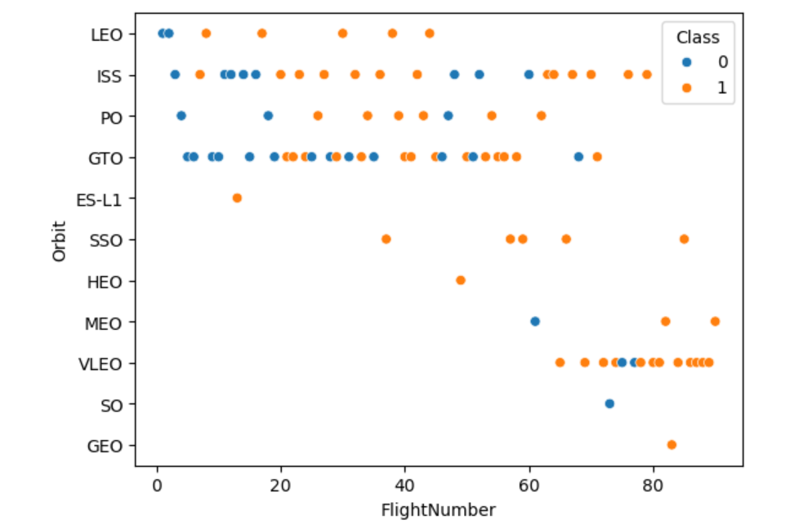
Flight Number vs. Orbit Type
Scatter point of Flight number vs. Orbit type
We can see from this scatter plot that the SSO orbit has no successful launches. For LEO orbits, as the number of flights increases, the number of successful launches also increases. For VLEO, we can observe some successful launches toward the end.

Slide 24
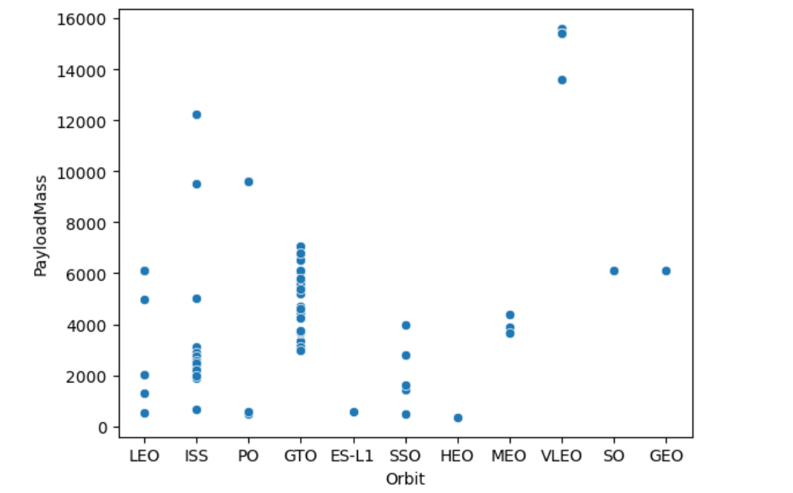
Payload vs. Orbit Type
Scatter point of payload vs. orbit type
There is no correlation between PayloadMass and Orbit

Slide 25
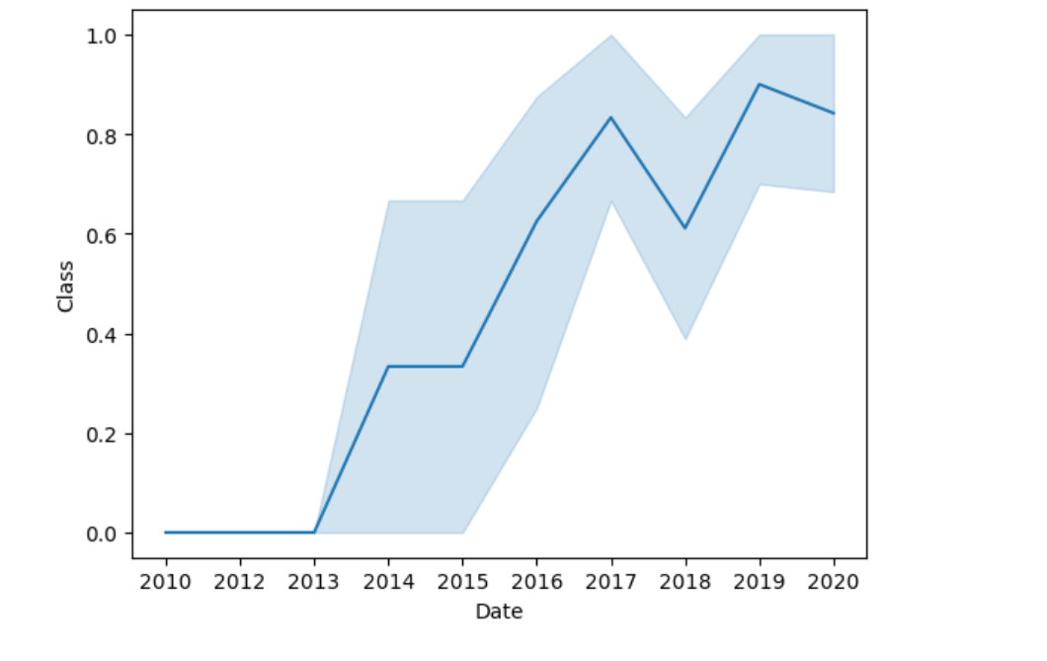
Launch Success Yearly Trend
Line chart of yearly average success rate
This graph shows that the success rate of launches has increased since 2013.

Slide 26
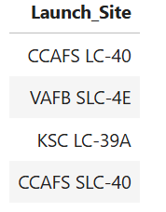
All Launch Site Names
Unique launch sites names
%sql select distinct Launch_Site from SPACEXTABLE ;
There are four different launch site

Slide 27
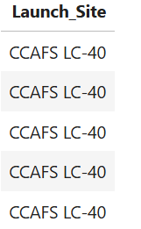
Launch Site Names Begin with 'CCA'
5 records where launch sites begin with `CCA`
%sql select Launch_Site from SPACEXTABLE where Launch_Site LIKE 'CCA%' LIMIT 5;

Slide 28

Total Payload Mass
Total payload carried by boosters from NASA
%sql select SUM(PAYLOAD_MASS__KG_) from SPACEXTABLE WHERE Customer = 'NASA (CRS)';
The Total payload carried by boosters is 45596 KG

Slide 29

Average Payload Mass by F9 v1.1
Average payload mass carried by booster version F9 v1.1
%sql select avg(PAYLOAD_MASS__KG_) from SPACEXTABLE where Booster_Version = 'F9 v1.1’;
The average of total payload carried by booster version F9 v1.1 is 2928.4

Slide 30
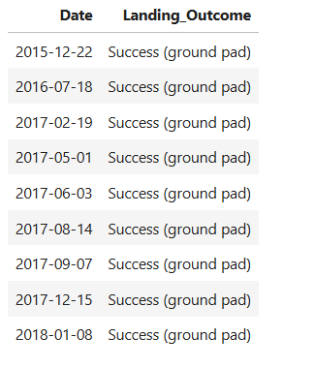
First Successful Ground Landing Date
Dates of the first successful landing outcome on ground pad
%sql select Date, Landing_Outcome from SPACEXTABLE where Landing_Outcome = 'Success (ground pad)' order by date asc;

Slide 31
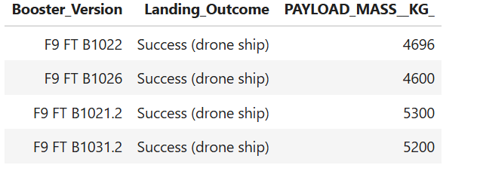
Successful Drone Ship Landing with Payload between 4000 and 6000
Names of boosters which have successfully landed on drone ship and had payload mass greater than 4000 but less than 6000
%sql select Booster_Version,Landing_Outcome,PAYLOAD_MASS__KG_ from SPACEXTABLE where Landing_Outcome = 'Success (drone ship)' and PAYLOAD_MASS__KG_ between 4000 and 6000;

Slide 32
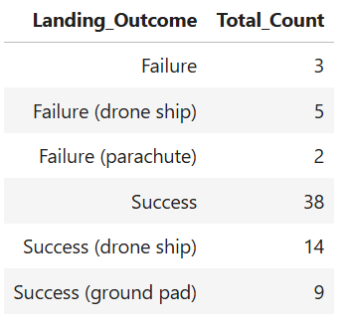
Total Number of Successful and Failure Mission Outcomes
Total number of successful and failure mission outcomes
%sql SELECT Landing_Outcome, COUNT(*) AS Total_Count FROM SPACEXTABLE WHERE Landing_Outcome LIKE 'Success%' OR Landing_Outcome LIKE 'Failure%'GROUP BY Landing_Outcome;

Slide 33
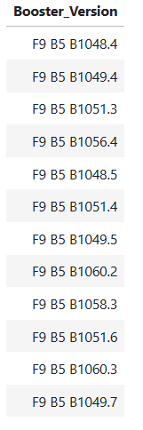
Boosters Carried Maximum Payload
Names of the booster which have carried the maximum payload mass
%sql SELECT Booster_Version FROM SPACEXTABLE WHERE PAYLOAD_MASS__KG_ = (SELECT MAX(PAYLOAD_MASS__KG_) FROM SPACEXTABLE);

Slide 34
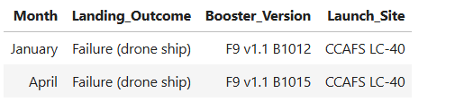
2015 Launch Records
Failed landing_outcomes in drone ship, their booster versions, and launch site names for in year 2015
%sql SELECT CASE WHEN substr(Date, 6, 2) = '01' THEN 'January’ WHEN substr(Date, 6, 2) = '02' THEN 'February’ WHEN substr(Date, 6, 2) = '03' THEN 'March’ WHEN substr(Date, 6, 2) = '04' THEN 'April’ WHEN substr(Date, 6, 2) = '05' THEN 'May’ WHEN substr(Date, 6, 2) = '06' THEN 'June’ WHEN substr(Date, 6, 2) = '07' THEN 'July’ WHEN substr(Date, 6, 2) = '08' THEN 'August'WHEN substr(Date, 6, 2) = '09' THEN 'September’ WHEN substr(Date, 6, 2) = '10' THEN 'October’ WHEN substr(Date, 6, 2) = '11' THEN 'November’ WHEN substr(Date, 6, 2) = '12' THEN 'December' END AS Month,Landing_Outcome, Booster_Version, Launch_Site FROM SPACEXTABLE WHERE substr(Date, 0, 5) = '2015' AND Landing_Outcome = 'Failure (drone ship)';

Slide 35
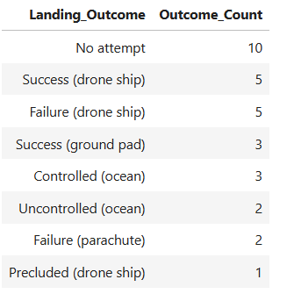
Rank Landing Outcomes Between 2010-06-04 and 2017-03-20
Ranking the count of landing outcomes (such as Failure (drone ship) or Success (ground pad)) between the date 2010-06-04 and 2017-03-20, in descending order
%sql SELECT Landing_Outcome, COUNT(*) AS Outcome_Count FROM SPACEXTABLE WHERE Date BETWEEN '2010-06-04' AND '2017-03-20' GROUP BY Landing_Outcome ORDER BY Outcome_Count DESC;

Slide 36
Section 3

Slide 37
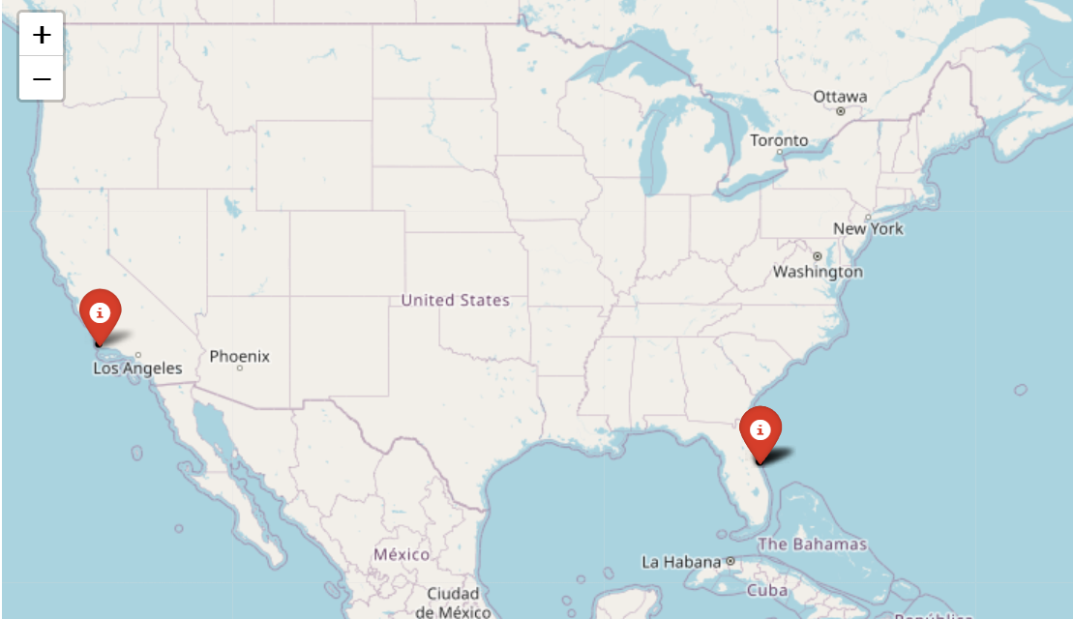
Interactive Map Visualization with Folium

Slide 38
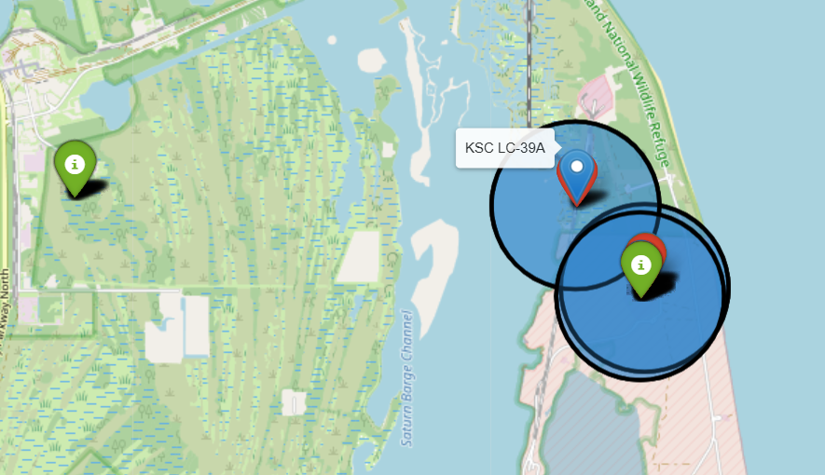
Folium Map showing the color-labeled launch outcomes
Exploring the folium map and make a proper screenshot to show the color-labeled launch outcomes on the map

Slide 39
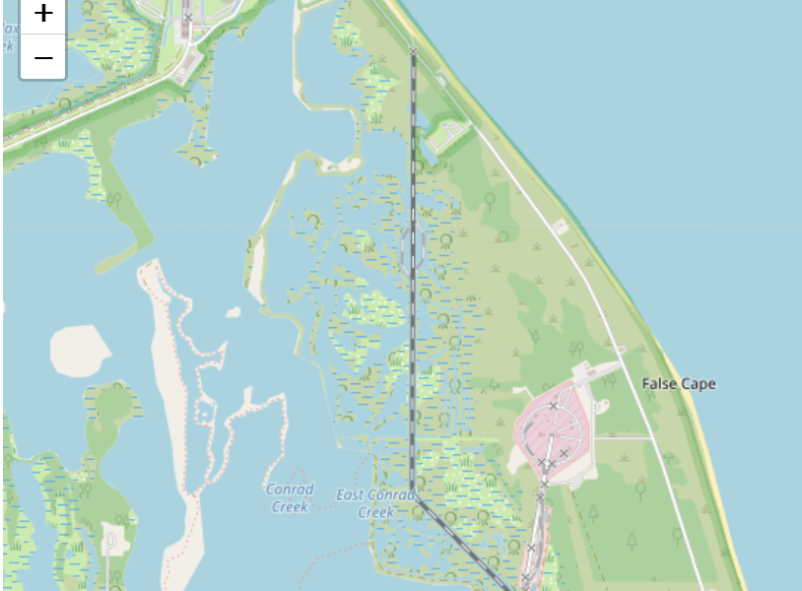
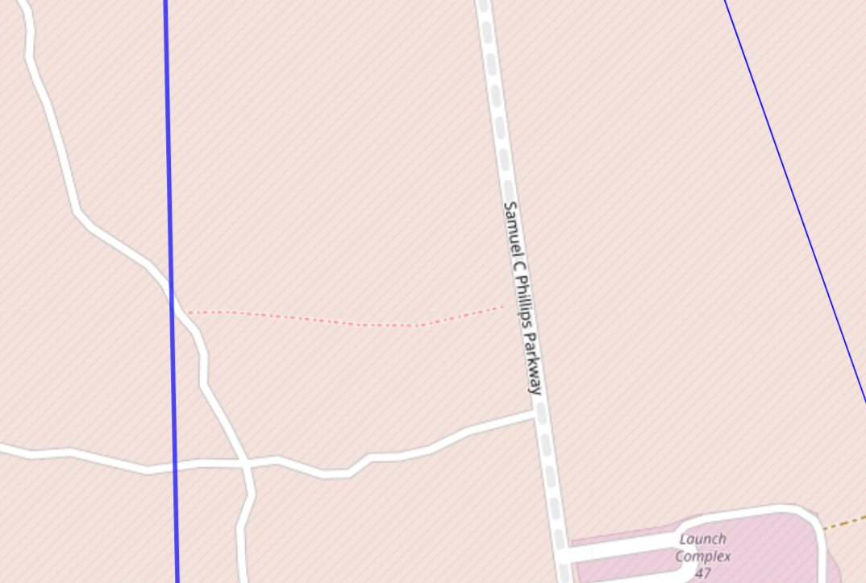
Folium Map showing a selected launch site to its proximities
Explain the important elements and findings on the screenshot

Slide 40
Section 4

Slide 41
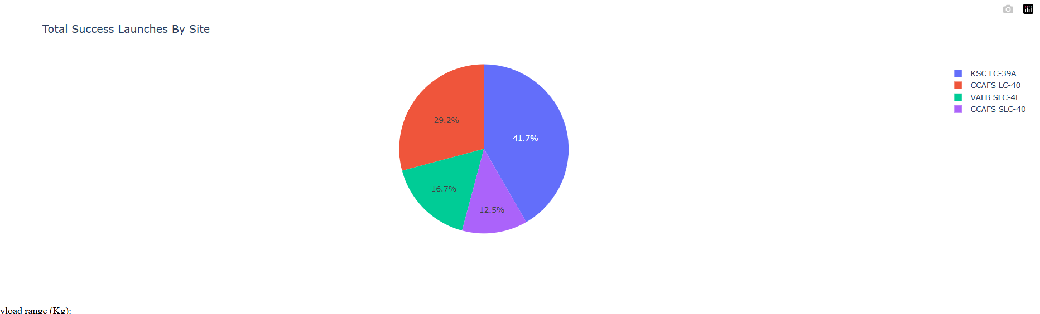
Total success launches by sites
This screenshot indicates that the KSC LC-39A launch site has recorded the highest number of successful launches. Conversely, the site with the fewest successful launches is VAFB SLC-4E.

Slide 42
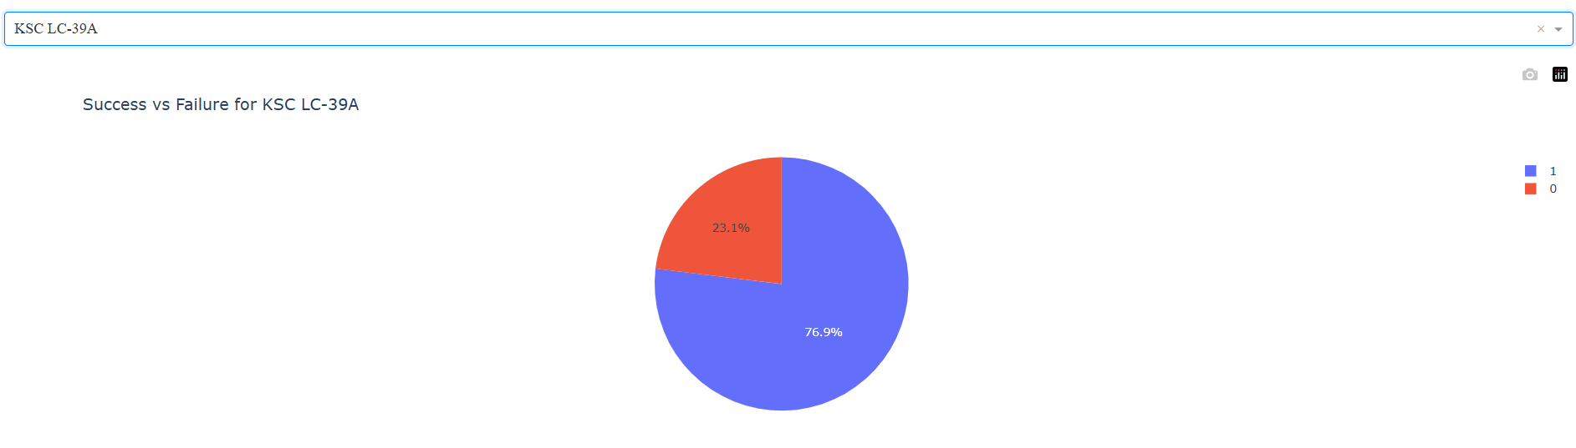
Pie chart of success vs failure for KSC LC-39A
The data reveals that the KSC LC-39A launch site has a success rate of 76.9%, while 23.1% of the launches from this site have resulted in failure.

Slide 43
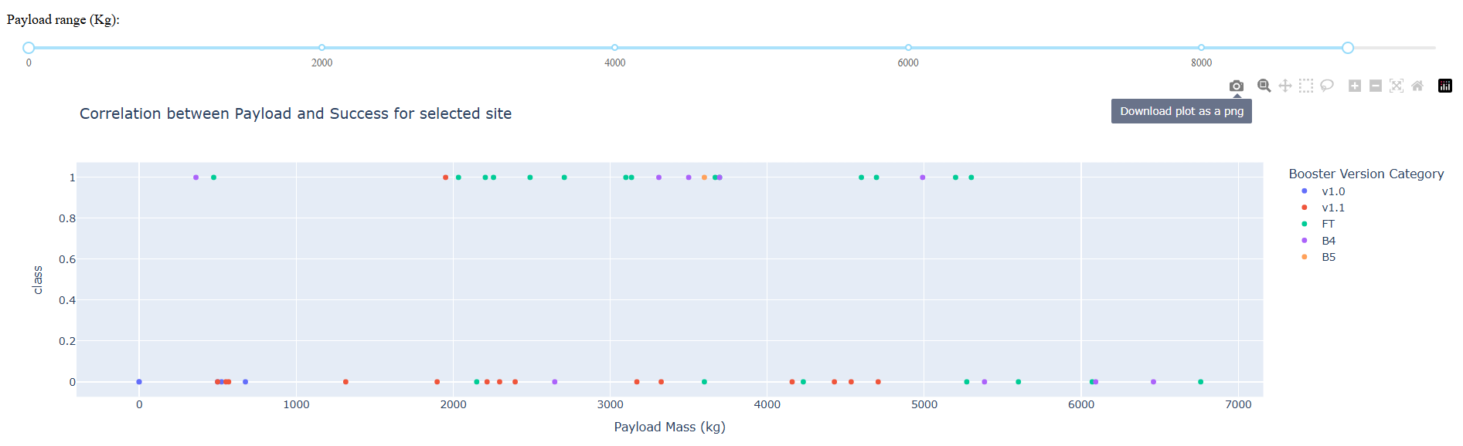
Correlation between payload and success for all site of launch

Slide 44
Section 5

Slide 45
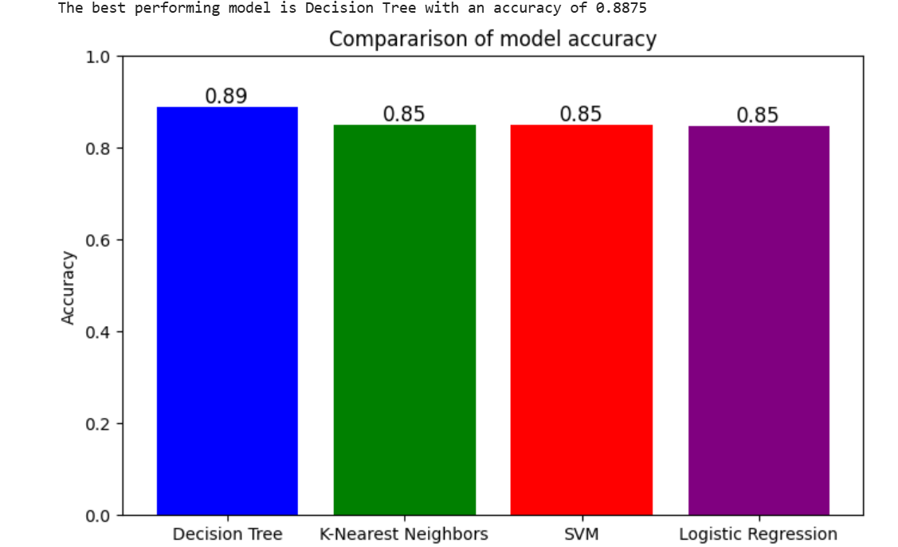
Classification Accuracy
The best mode is decision Tree with an accuracy = 0.89

Slide 46
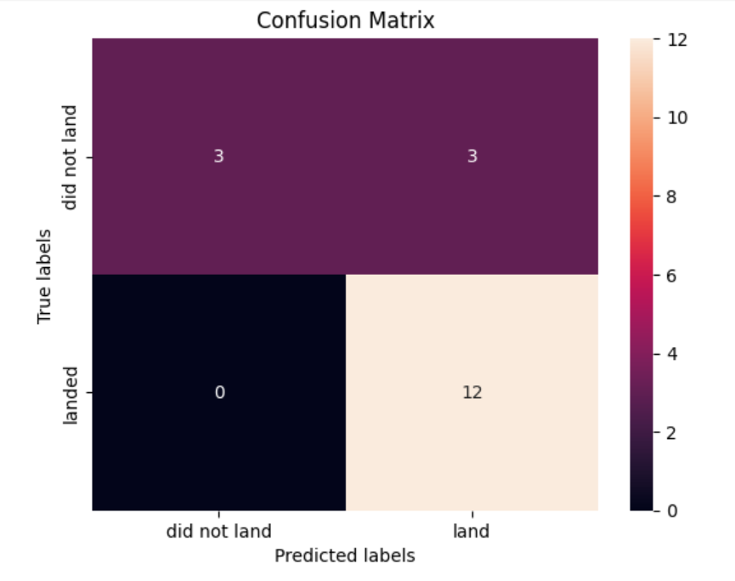
Confusion Matrix

Slide 47
Conclusions
The best-performing model is the Decision Tree.
KSC LC-39A is the launch site with the highest success rate.
Payload mass and the number of launches are key factors to consider.
Orbits like LEO, and GTO could be prioritized.

